Slide 1
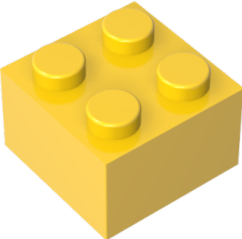

Slide 2

Play

Slide 3

Bricks
Builder
Play

